Slide 1
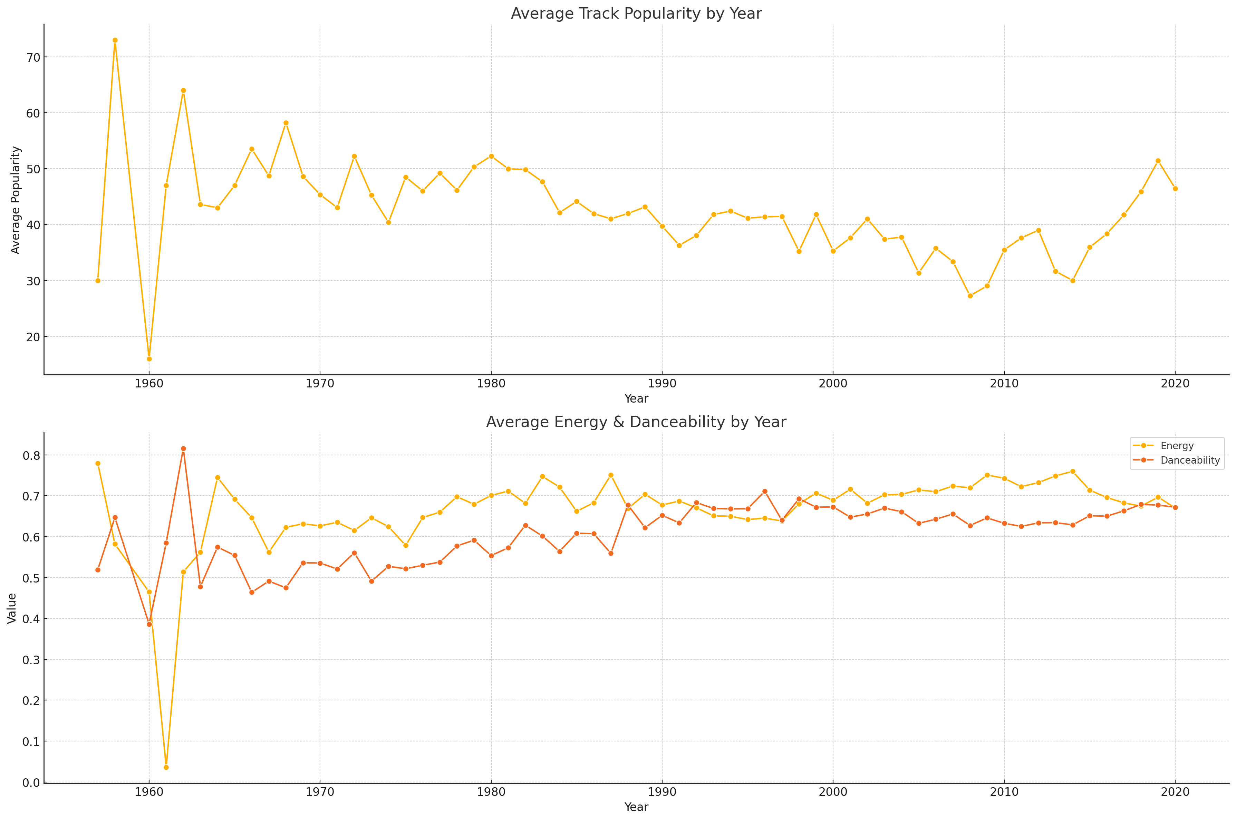

Slide 2

Evolving Popularity: Peaks & Trends in Top Artists' Music (2015-2019)
Key Insights:
• The chart highlights significant fluctuations in track popularity by year. • Increasing track popularity post-2015 suggests evolving listener preferences.

